Slide 1

Team Faucet
Quest for the Dodo Egg 2
Alex Parenti, Devin Driggs, Drew Canham, Garrett Oetken, Luke Hill, Miranda Ronald, Travis Rousey, Zach Moreno, Zane Goodrick
Notes:
Introduce Group Members

Slide 2
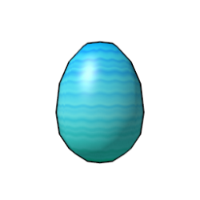


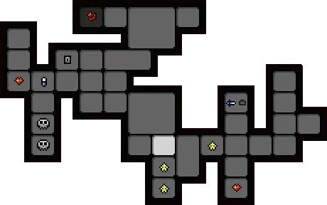
Quest for the Dodo Egg 2
Defeat the wumpus...
Explore dark dungeons...
Find the Dodo Egg of Yendor...
Save the world...
Notes:
Give a brief introduction to the game

Slide 3
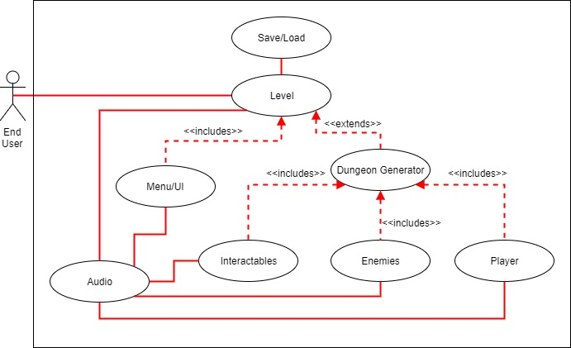
Global Use Case
Notes:
Walkthrough of a global use case involving all members and showing which data is passed between sub-systems.

Slide 4
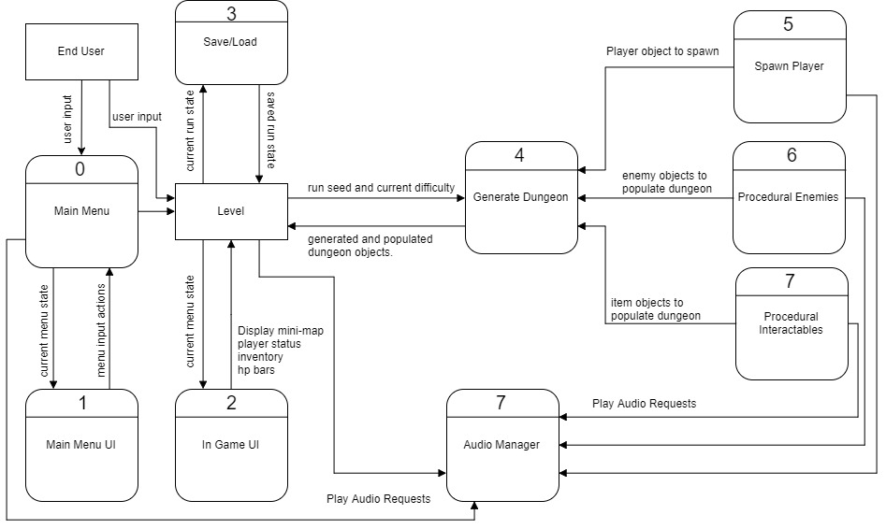
Context Diagram
Notes:
Introduce project using Context Diagram and any sample screen shots.

Slide 5
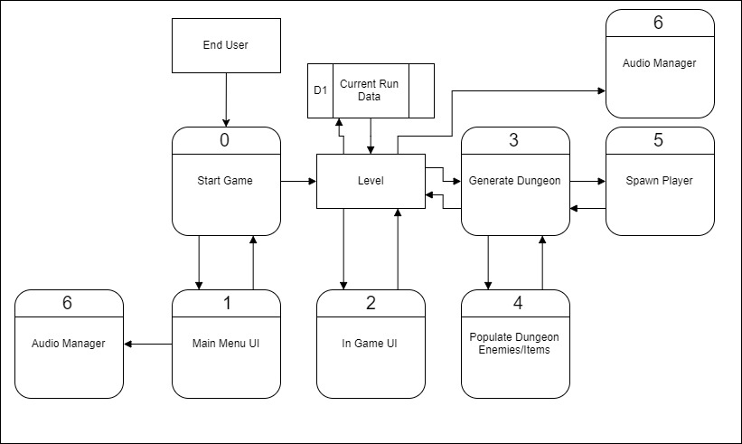
Diagram 0
Notes:
Break down project with diagram 0

Slide 6
Alex - Procedural Level Generation
Algorithm to generate random dungeons
Increasing size and difficulty of levels
Populate dungeon with items, interactables, and enemies
Spawn player
Coordinate with Luke for camera controls.
Coordinate with saving/loading team
Priority: 1
Difficulty: Moderate-High
Notes:
Re-introduce yourself Introduce your feature (ensure you explain its role in the overall project)
Tell how high of a priority your feature is
Estimate the complexity of the work relative to the other features

Slide 7
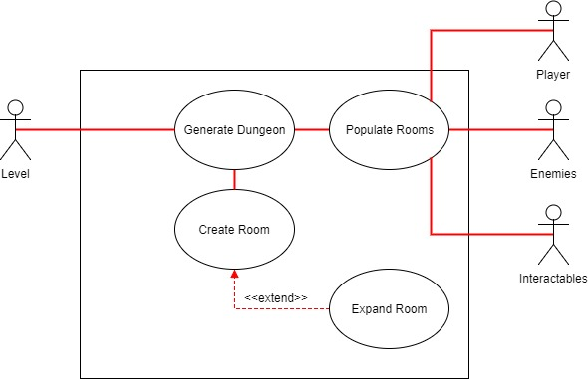
Procedural Level Generation - Use Case
Notes:
Walk through your use case diagram
Answer any questions

Slide 8
Player - Overview - Luke
Who am I?
What is the Player?
Load player (default or from save)
Health points, coordinating weapons and inventory with Travis.
Move player, use weapons and tools (accepting mouse and keyboard input)
Store health points (HP) and sprite information.
Player-interactables (Devin/Travis)
Items that make Player invincible
Walls/obstacles
Priority: 1 (Must have) You can’t play a game without a player!
Difficulty: Moderate
Coordination with Enemy and Interactables
Data storage and manipulation
Calling Audio Manager
Notes:
Re-introduce yourself Introduce your feature (ensure you explain its role in the overall project)
Tell how high of a priority your feature is
Estimate the complexity of the work relative to the other features

Slide 9
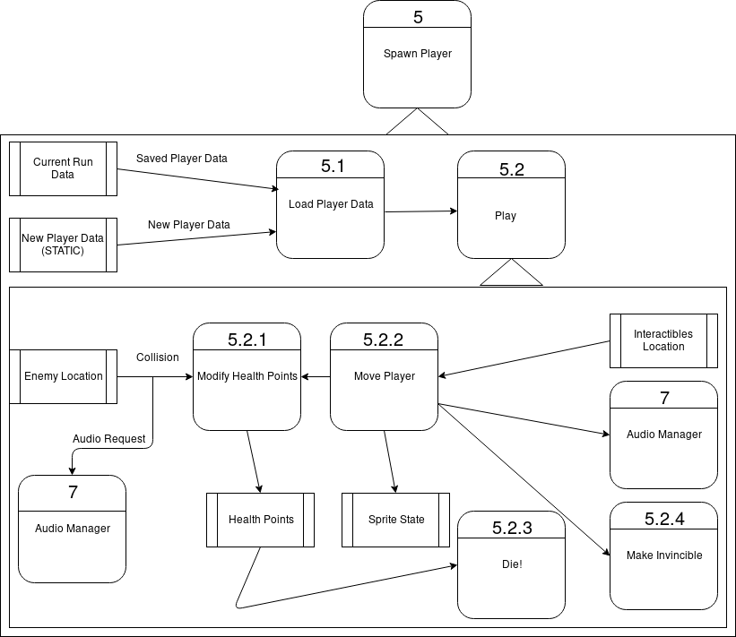
Player - Data Flow Diagram

Slide 10
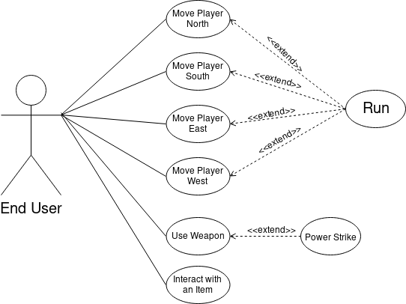
Player - Use Case Diagram
Questions?
Notes:
Walk through your use case diagram
Answer any questions

Slide 11
Garrett - Enemy
I will work with Travis on computer generated non-player enemies.
Enemies will have the ability to:
Generate in the procedural levels
Attack the Player
Respond to attacks from Player (take damage/die)
Drop items when killed
I will coordinate with the Player team to build the Enemy class as a subclass of the Player class, being able to utilize functions such as initializing the Player, getting Player statistics, and modifying health points (HP).
Priority Level: 2 - Feature is essential to game flow but technically game will run without this feature
Difficulty: Moderate - requires collaboration with other parts such as Player, Interactables, and Level Generation.
Notes:
Re-introduce yourself Introduce your feature (ensure you explain its role in the overall project)
Tell how high of a priority your feature is
Estimate the complexity of the work relative to the other features

Slide 12
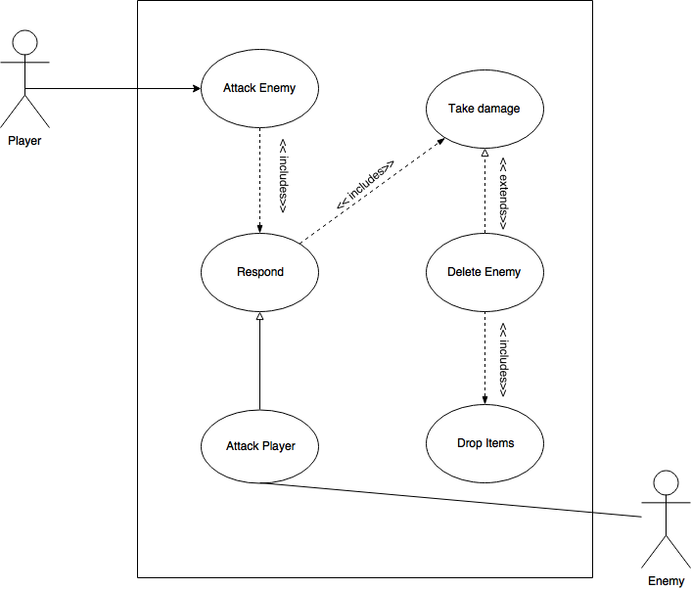
Enemy - Use Case
Notes:
Walk through your use case diagram
Answer any questions

Slide 13
Interactables - Devin
Purpose:
Create doors between levels and link them to logistics and keys
Create chests that contain procedurally generated items
Create Obstacles that can be moved by pushing
Create mario-style power-ups (both good and bad)
Cooperate with…
Level to generate interactables in
Player and enemy to interact with
Inventory with chests and item generation
Priority – medium:
Game can function without interactables, but they add a lot to the game
Complexity - medium:
Heavy interaction with Player and Level, light interaction with inventory and enemy.
Notes:
Re-introduce yourself Introduce your feature (ensure you explain its role in the overall project)
Tell how high of a priority your feature is
Estimate the complexity of the work relative to the other features

Slide 14
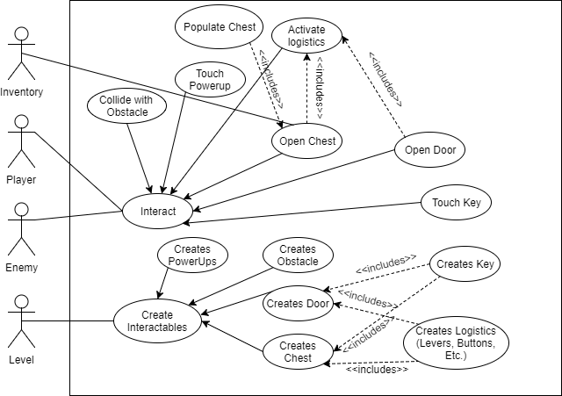
Interactables - Use Case
Notes:
Walk through your use case diagram
Answer any questions

Slide 15
Inventory objects - Travis
Purpose:
Creating items that are usable and can be stored in the inventory (buffs, potions, weapons and armor)
Ensure interactable objects that can be picked up, when the player runs into the object and then stored in inventory, are pathed correctly.
Work closely with the Player and Enemy team to make sure enemy drops items and the player can pick and store those items.
Create an inventory to display accrued items.
Cooperate with UI to make sure the user can access the inventory.
Priority – low:
Game can function without supplementary items in an inventory
Complexity - medium:
Interacts with player, enemies, interactables, level and UI.
Notes:
Re-introduce yourself Introduce your feature (ensure you explain its role in the overall project)
Tell how high of a priority your feature is
Estimate the complexity of the work relative to the other features

Slide 16
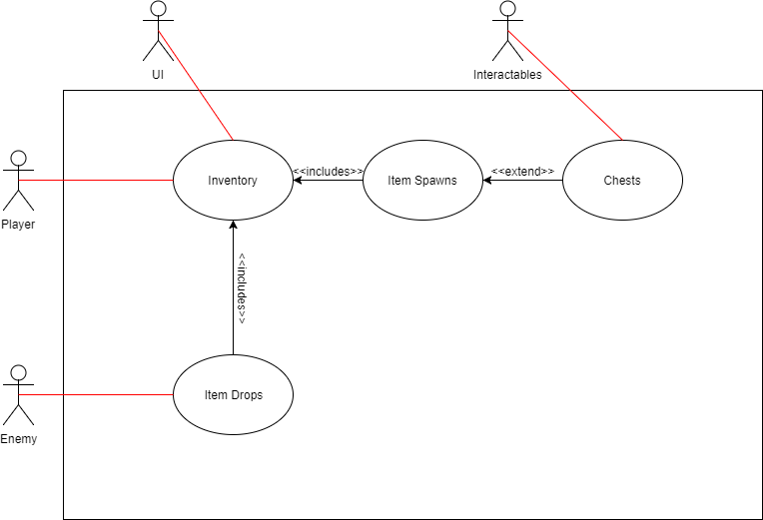
Inventory objects - Use Case
Notes:
Walk through your use case diagram
Answer any questions

Slide 17
UI - Zach
I’ll be partnered with Miranda to develop the main menu, settings menus, and in-game user interface.
-My focus will be to create a user-friendly main menu with straightford navigation, including, but not limited to:
-Start Game, Load Game, Settings, Help, Exit Game
-Simplicity will be the goal so that a user may maneuver the menus with ease to find what they are looking for quickly.
-Settings will focus mostly on in-game audio options, HUD display, and possibly difficulty level.
-Help menu will not be interactive, but will provide thorough instructions for key bindings, etc.
Priority: Medium - Seamless transition to start of game necessary, complexity not a key factor to game experience
Complexity: Low - Organize menus, launch game on Start, launch saved game on Load, etc.
Notes:
Re-introduce yourself Introduce your feature (ensure you explain its role in the overall project)
Tell how high of a priority your feature is
Estimate the complexity of the work relative to the other features

Slide 18
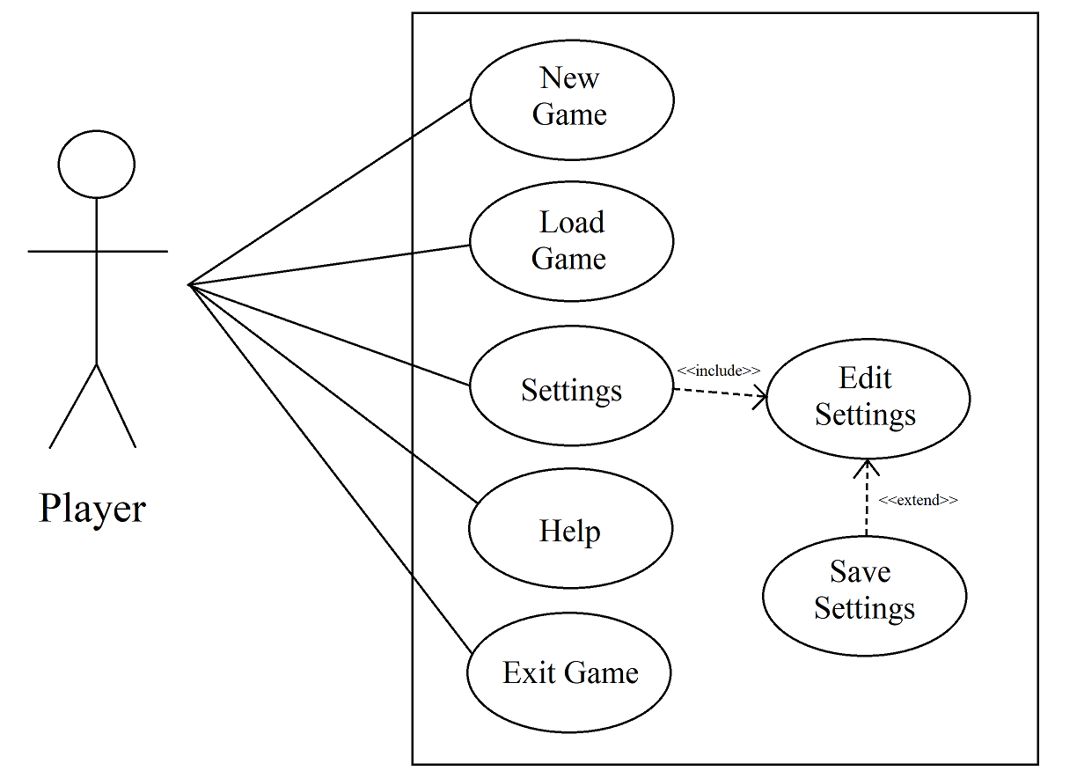
Main Menu - Use Case
Notes:
Walk through your use case diagram
Answer any questions

Slide 19
UI - Miranda
-I will be working with Zack to help with UI. I will be making menus that:
-Track player health
-Have menus over head of the enemies to track health
-We will also need to work with Travis to create an inventory menu so the player can access their objects.
Complexity : Medium, Interacts with player, inventory.
Priority : 2 - User needs a way to access inventory
Notes:
Re-introduce yourself Introduce your feature (ensure you explain its role in the overall project)
Tell how high of a priority your feature is
Estimate the complexity of the work relative to the other features

Slide 20
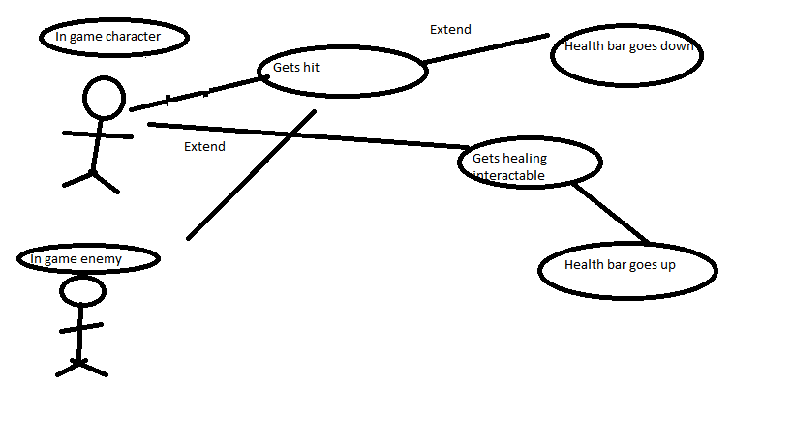
UI - Use Case
Notes:
Walk through your use case diagram
Answer any questions

Slide 21
Audio - Zane
Purpose:
Background music for level that changes depending on whether or not the player is in conflict
Compressed/modified audio files for optimal load times
Various sounds to accompany:
Player (attacking, taking damage, being defeated)
Enemy (attacking, taking damage, being defeated)
Interactables (pickup/use of items, doors, movables)
UI (navigation/selection sounds for menus)
Priority - 2:
Game can function without but loses immersion
Complexity - low- medium:
Interacts with everything except saving/loading
Notes:
Re-introduce yourself Introduce your feature (ensure you explain its role in the overall project)
Tell how high of a priority your feature is
Estimate the complexity of the work relative to the other features

Slide 22
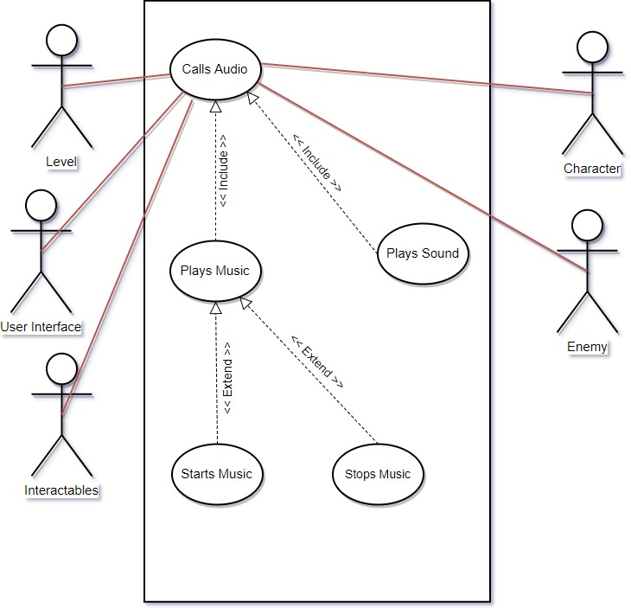
Audio - Use Case
Notes:
Walk through your use case diagram
Answer any questions

Slide 23
Saving/Loading - Drew
Purpose:
I will be working with every other part of the project to get the important variables which will be saved to the disk
This information will be able to be loaded into memory at a later date to continue from where it was saved
Priority - low:
The game should still be perfectly playable even without saving/loading, though it will be inconvenient for the player.
Complexity - medium-low:
Interacts with everything else, but is conceptually simple.
Notes:
Re-introduce yourself Introduce your feature (ensure you explain its role in the overall project)
Tell how high of a priority your feature is
Estimate the complexity of the work relative to the other features

Slide 24
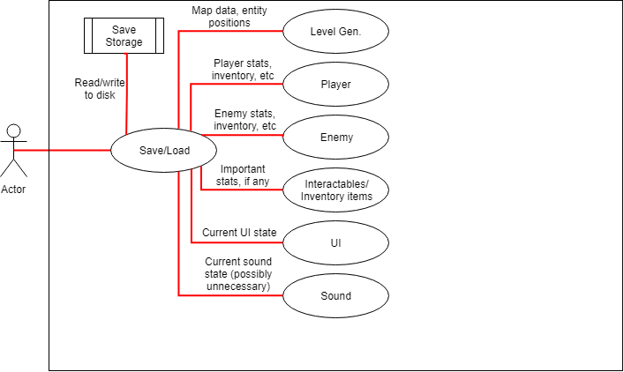
Saving/Loading - Use Case Diagram
Notes:
Walk through your use case diagram
Answer any questions

Slide 25
Diagram 0
Notes:
Break down project with diagram 0

